Slide 1

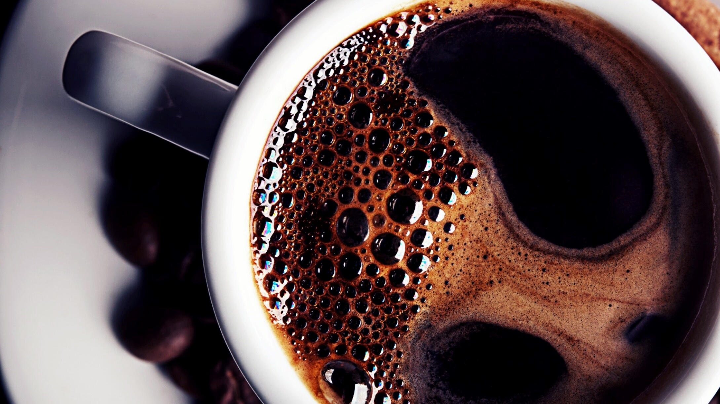
Out to lunch

Slide 2
Cats and birds have a habit to sleep in the afternoon. For humans, some people in some countries have this habit but others don’t.
For example in Spain, there is a rule that companies, stores, and all occupation
must take a break to nap in the afternoon.
If you see Spain between 1:30 and 4, you will understand there’s anybody in streets or no birds in the sky.
All workplaces in this country are closed to give people some time to have lunch and take a nap. This period is called “siesta”.
Pier Robert says,” I used to try to get a job in the afternoon, but I saw nowhere is opend. I walked in the streets. And the city looked a ghost town.”
In many countries such as Iran, sleeping in the afternoon is usual but in Spain, people have to stop working and take a nap and have lunch with their friends which is very bad for tourist industry.
This habit refers to an ancient culture. Health and cheerfulness are more important than working. There isn’t anything more important than hanging out with family and eating.
After the siesta, people will keep on working until 8 p.m. they eat dinner at about 9 or 10 p.m. They are out until 2 a.m. and participate in the ceremonies or parties. it would make them happy.
opened

